Slide 1
Cellular liquid-liquid condensates are amazing

Slide 2
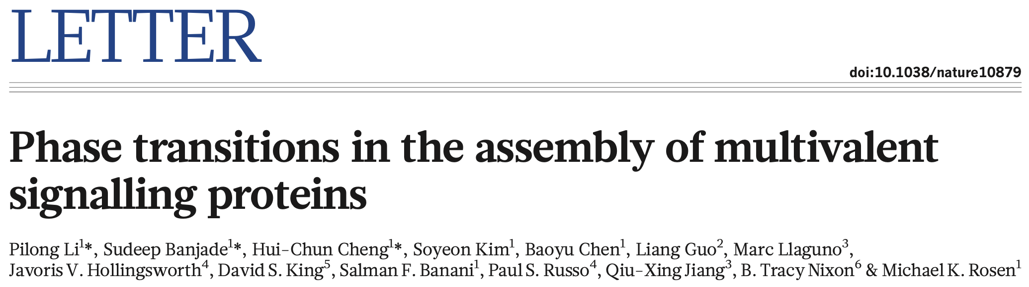
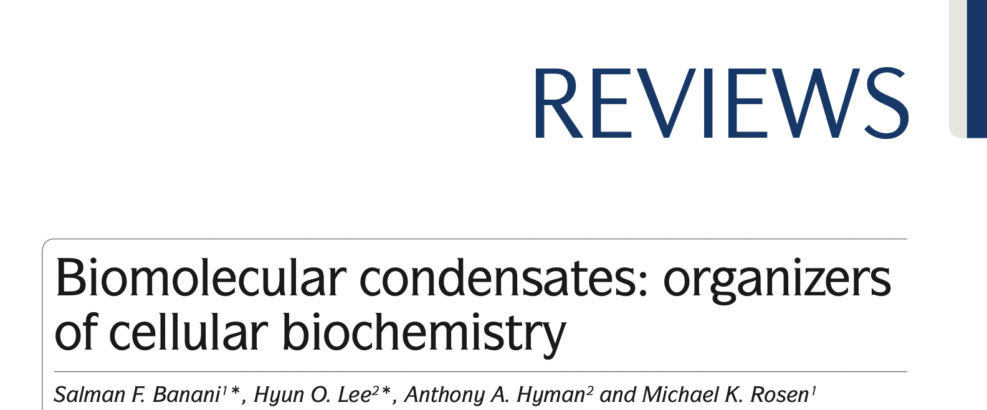

Slide 3
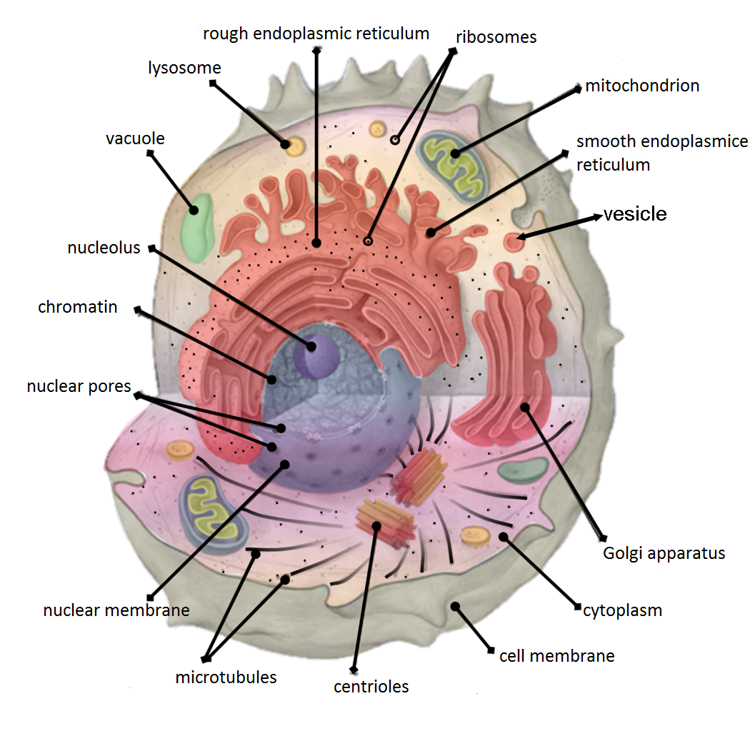
Wikimedia.org

Slide 4
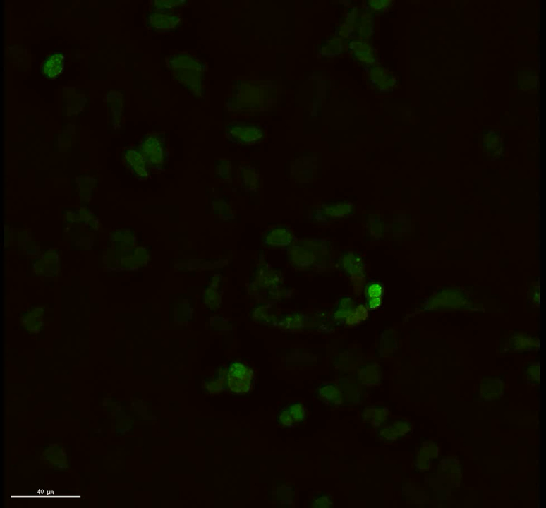
Tia1-GFP
Coxsackievirus
B3 marker

Slide 5
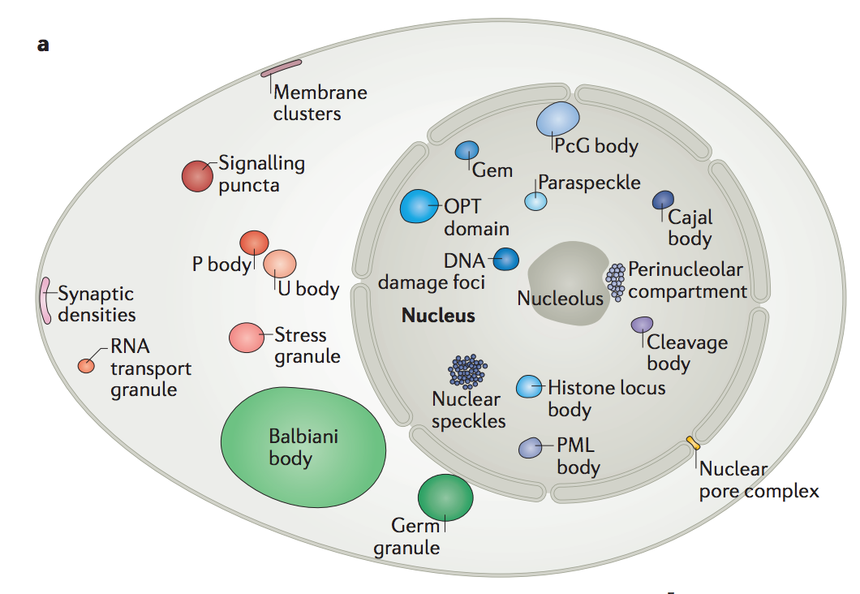

Slide 6
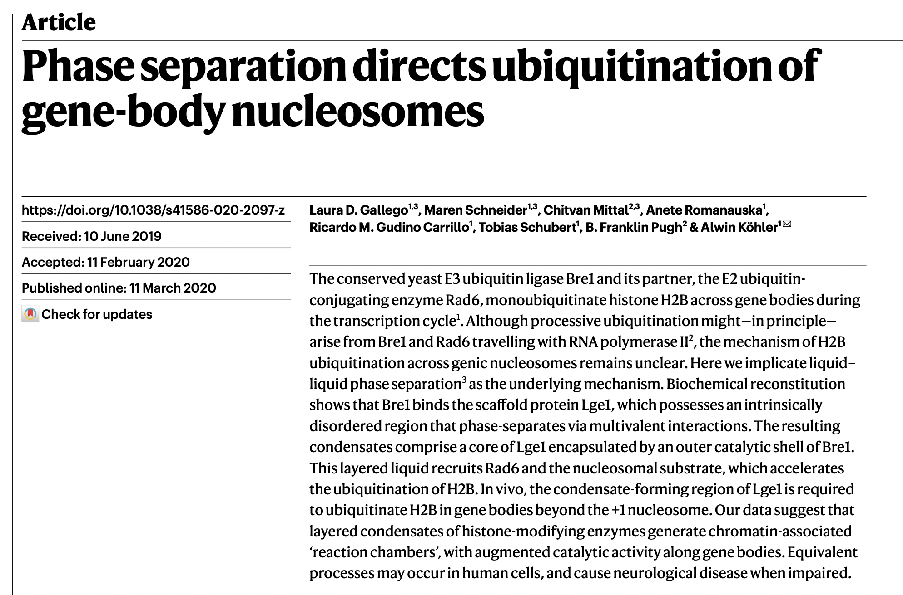

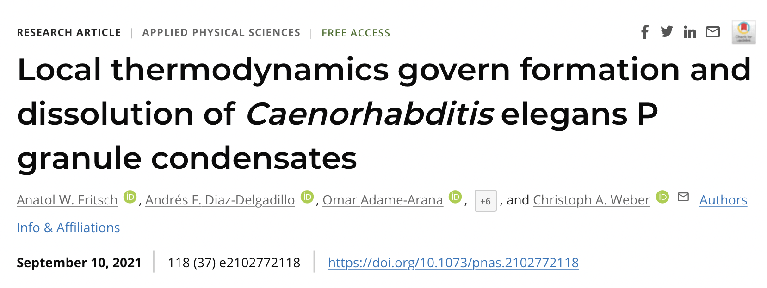
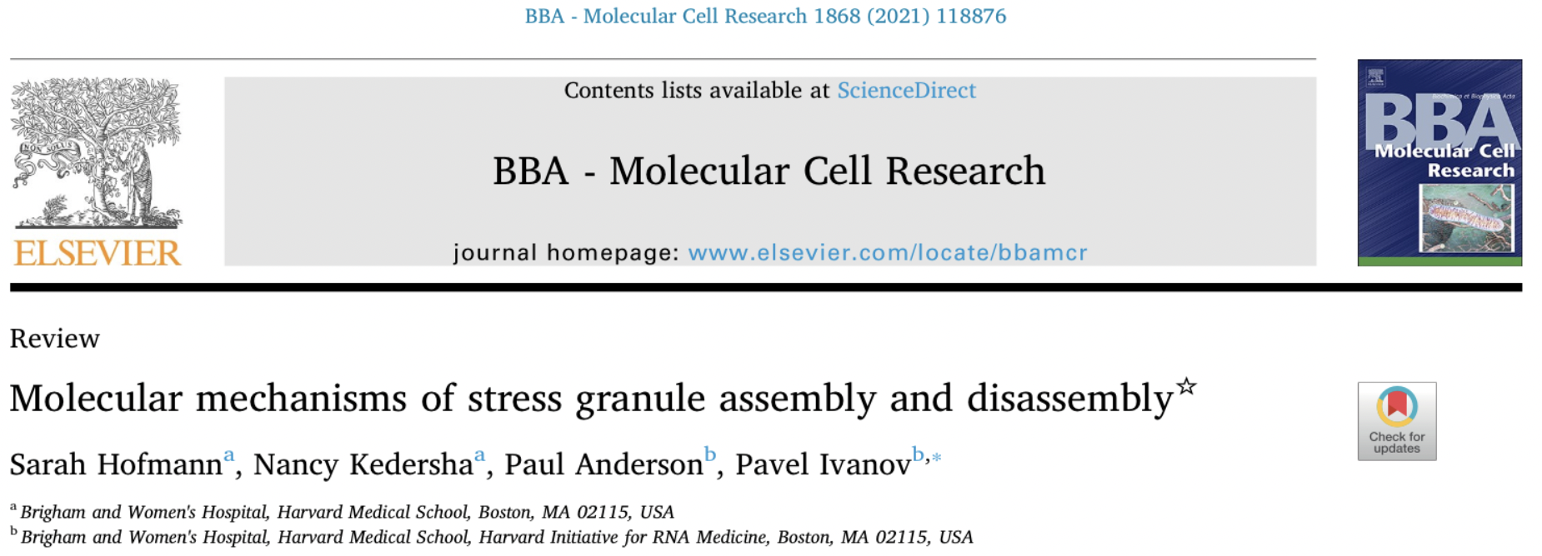

Slide 7
These structures are very weird

Slide 8
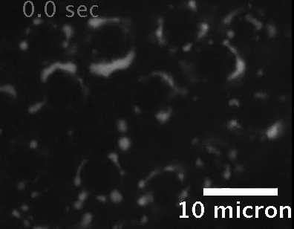
Extracted p-granules “drip”

Slide 9
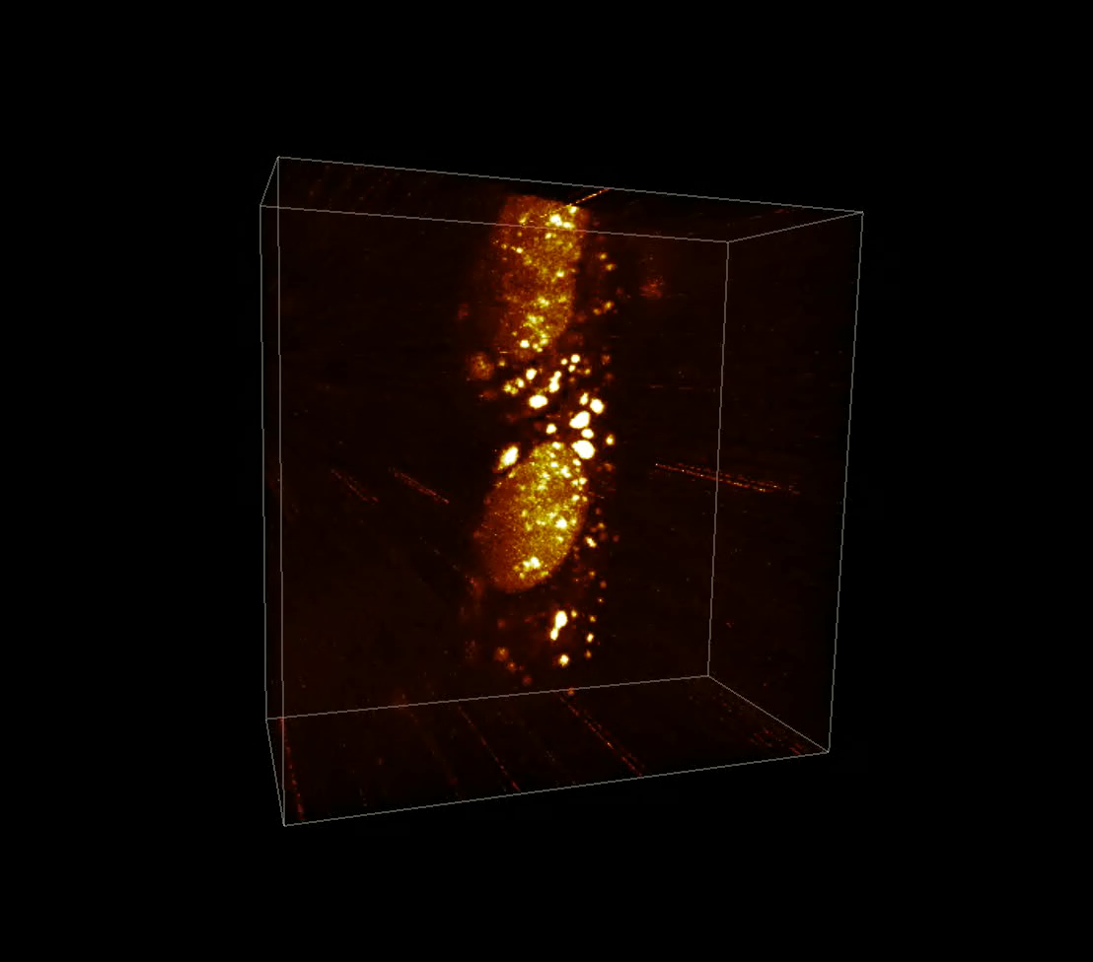
Stress granules fuse in cells

Slide 10
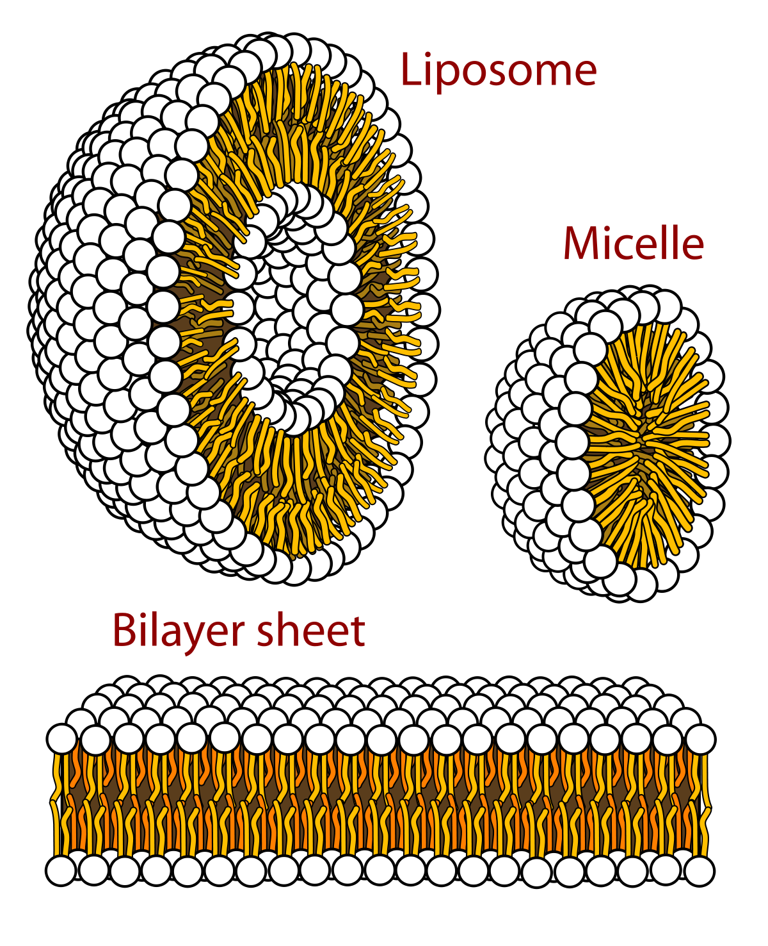
Phospholipids do this sort of thing…
Wikimedia.org

Slide 11
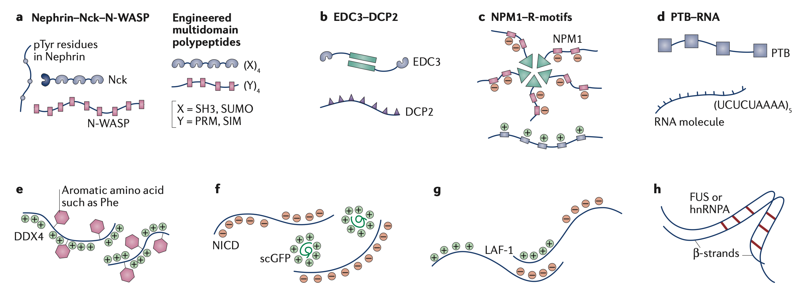
But condensates are made of stuff like this:

Slide 12
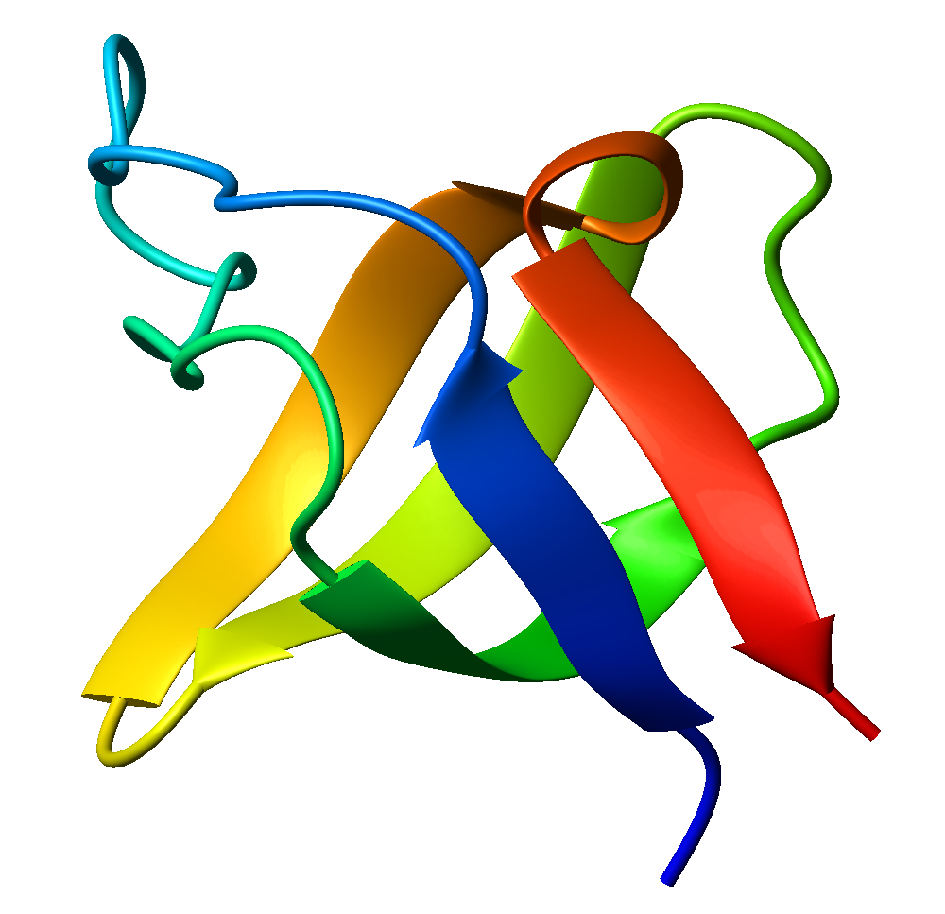
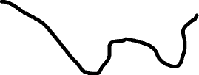
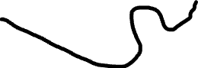
How does a chain of soluble proteins end up forming stable droplets in cells???

Slide 13
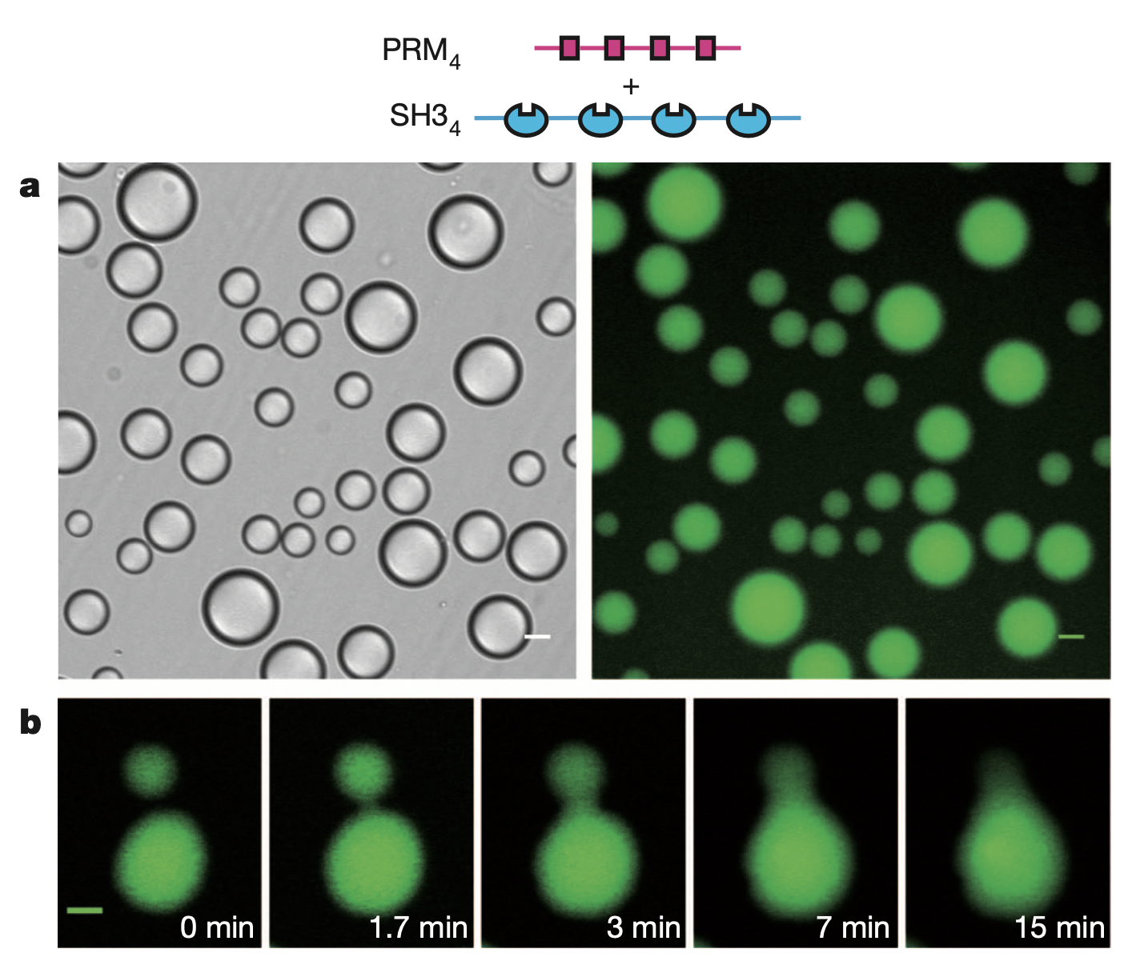
PRM₄ and SH3₄
phase separate
in vitro

Slide 14
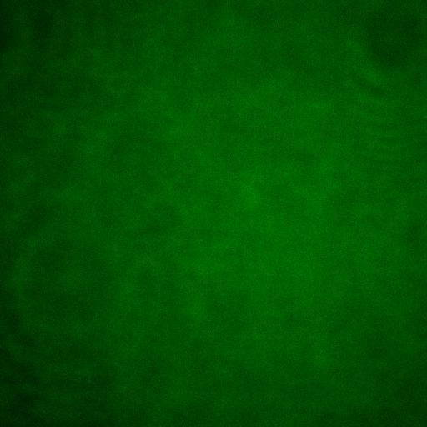

Slide 15
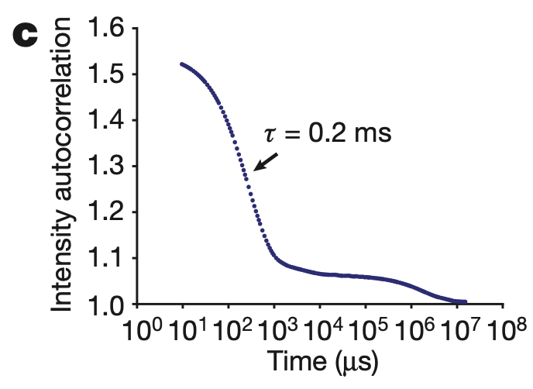
Right-angle light scattering on droplets gives a bunch of different long-time correlations

Slide 16
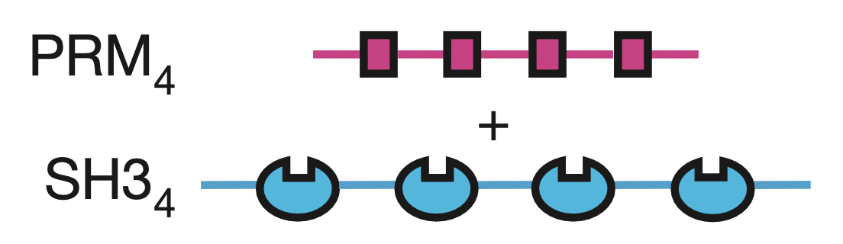
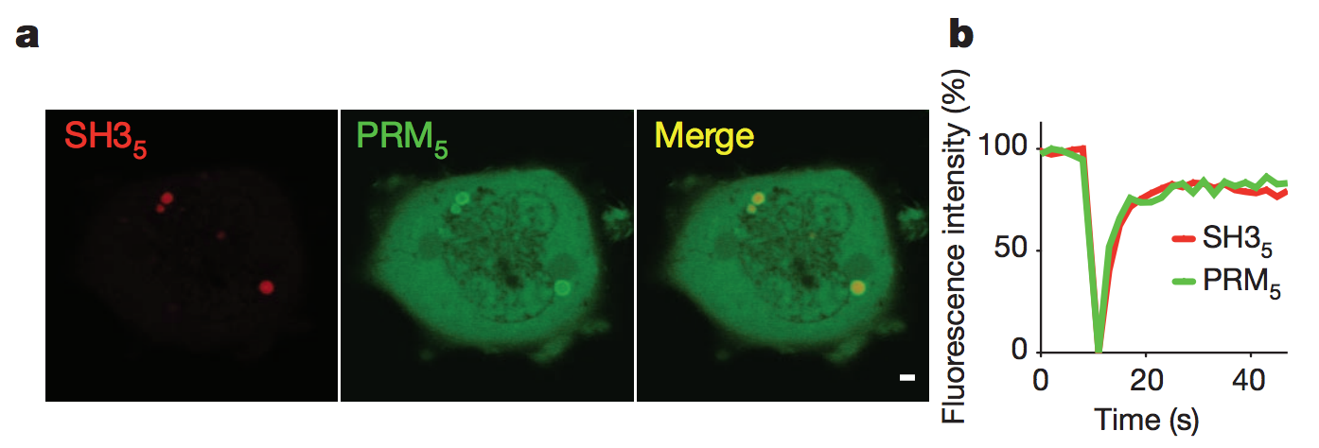
PRM₅ and SH3₅
recover from photobleaching
in cells

Slide 17
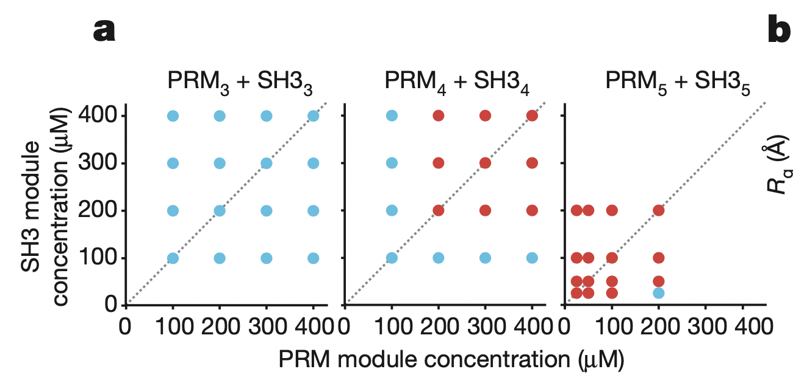
Phase separation depends
on valency in vitro

Slide 18
Why does multi-valency lead to phase separation?

Slide 20
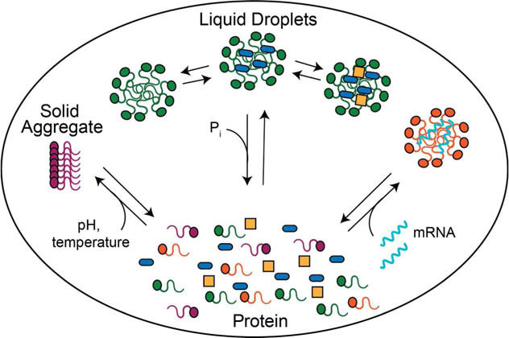
Itakura et al. (2018)

Slide 21
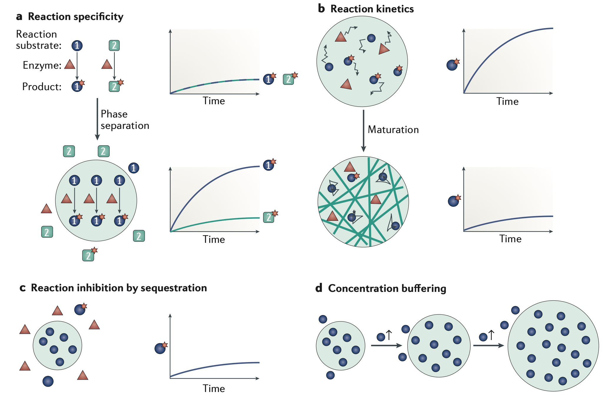
What are condensates useful for in cells?

Slide 22
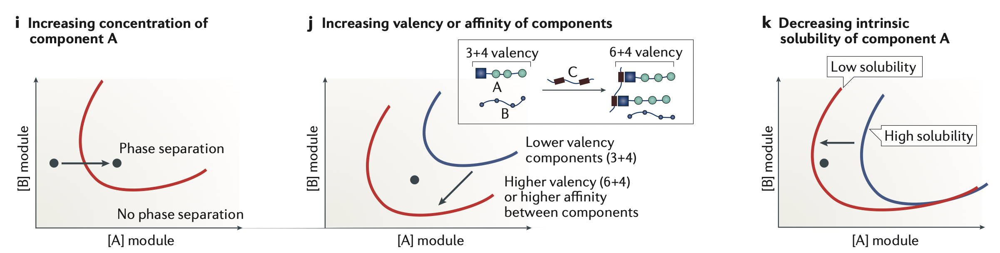
How can cells turn condensates on and off?

Slide 23
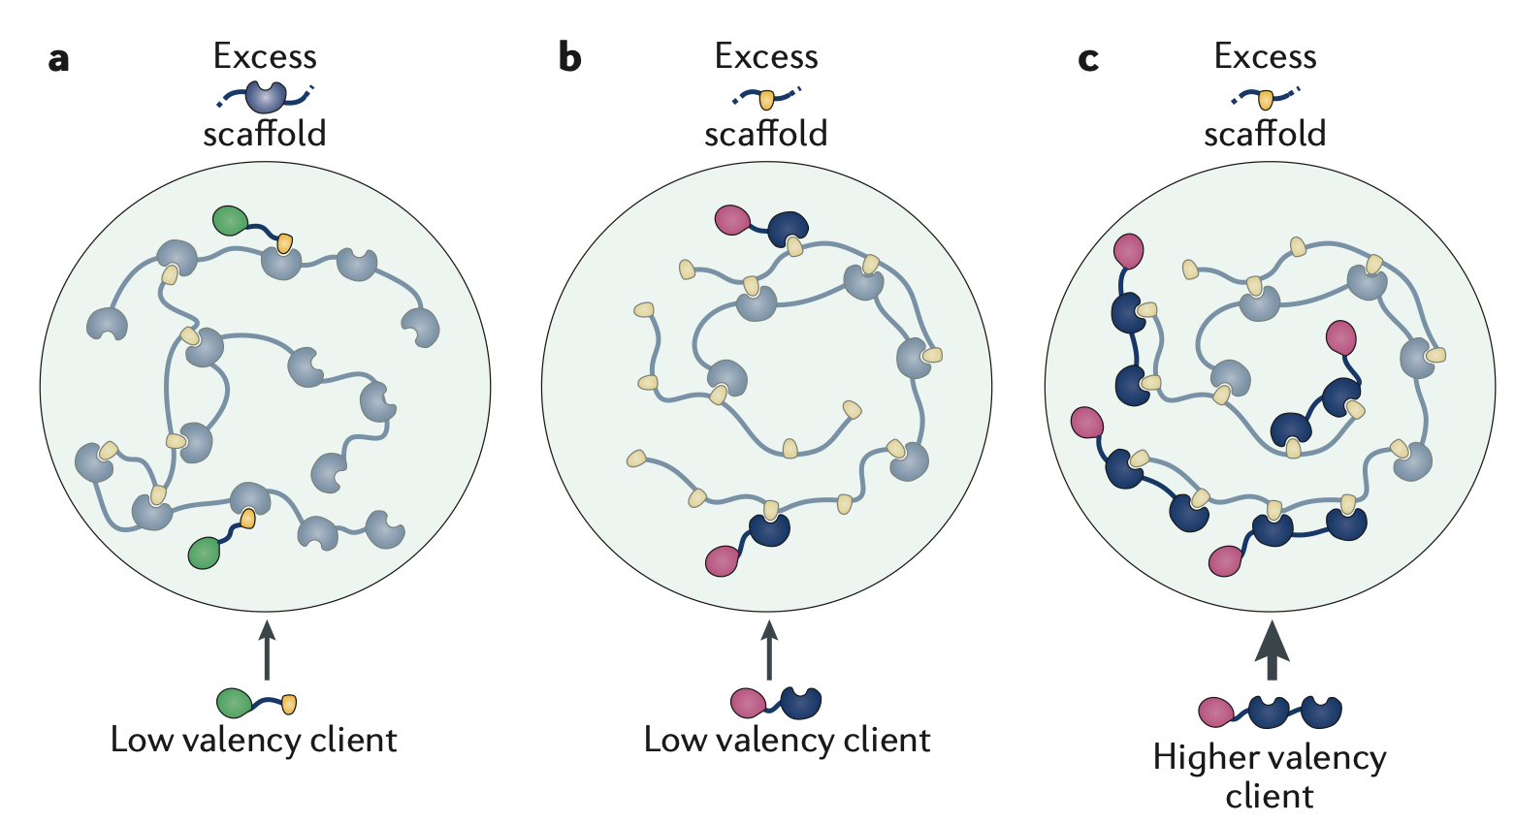
How do cells control what ends up on condensate?

Slide 24
Condensates are a key mechanisms cells use to control chemistry in a spatially and temporally organized manner
Condensates form when multivalent molecules form specific interactions with each other. Their avidity traps the molecules in a liquid-liquid state.
By changing concentration, valency, and domain composition, cells control what goes into each condensate.

